Slide 1
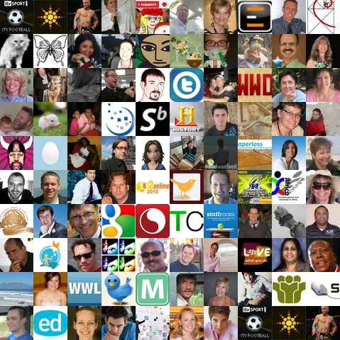
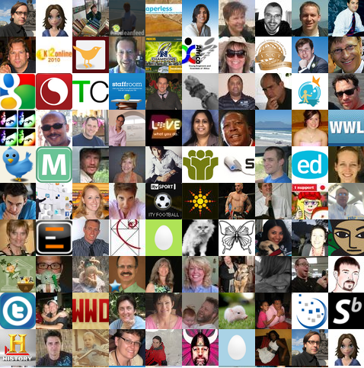




ICT in the classroom conference
Twitter twinking
Twitter Twinking
A higher order thinking tool
Maggie Verster
www.ICT4Champions.za
www.school2.co.za
Notes:
[twitter]This presentation can be found on my www.school2.co.za blog [/twitter]
[twitter] Follow the conference hashtag or go to my Facebook fanpage www.ict4champions.co.za [/twitter]

Slide 2

ICT in the classroom conference
Twitter twinking
Setting the stage
www.twitter.com or
m.twitter.com
Conference hashtag
#schoolnetsa11
Conference twit/twat/twinker
www.twitter.com/maggiev
www.ict4champions.co.za
(Facebook Page)
Are you tweeting yet?
Notes:
[twitter] setting up the back cannel: connect on your mobiles at m.twitter.com or use FB application on smartphones [/twitter]
[twitter] A basic step by step to register for a twitter account can be found here: http://www.slideshare.net/maggiev/africa-highered-ict-conference-2011 [/twitter]
[twitter] #schoolnetsa11 day 1: http://ow.ly/4pYqK [/twitter]

Slide 3
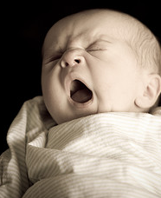
ICT in the classroom conference
Twitter twinking
Boring/Not?
Notices
Post assignments
Summaries
News sources
Passing on reading and resources
Are you/we thinking yet?
Notes:
Picture source:
http://farm3.static.flickr.com/2363/2157610777_d6d62270ca_m.jpg
[twitter]#schoolnetsa11 100 ways to teach with twitter http://www.emergingedtech.com/2010/02/100-ways-to-teach-with-twitter/ [/twitter]
[twitter] 50 Ways to Use Twitter in the College Classroom http://www.onlinecolleges.net/2009/06/08/50-ways-to-use-twitter-in-the-college-classroom [/twitter]
[twitter] report on study of how HED are using twitter 2010 http://www.facultyfocus.com/free-reports/twitter-in-higher-education-2010-usage-habits-and-trends-of-todays-college-faculty [/twitter]

Slide 4
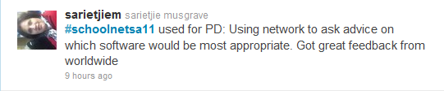

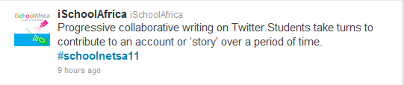
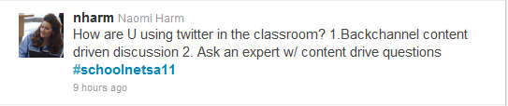
ICT in the classroom conference
Twitter twinking

Slide 5

ICT in the classroom conference
Twitter twinking
Why I love it
Communication
Relationship building
PLN
Professional development
Passing on cutting edge reading and resources
Conference backchannel
Connecting students on projects globally
Are we thinking yet?
Notes:
http://www.flickr.com/photos/webagentur24/2988615491/
[twitter]#schoolnetsa11 How to set up twitter as a conference backchannel: http://c4lpt.co.uk/140Learning/presentation.html [/twitter]
[twitter]#schoolnetsa11 Twitter and PowerPoint tools http://www.sapweb20.com/blog/powerpoint-twitter-tools/instructions/#twitterupdate [/twitter]
[twitter] #schoolnetsa11 @holleyrae ‘s great twitter presentation: http://www.slideshare.net/hollyrae/twitter-in-education-considerations-possibilities [/twitter]

Slide 6
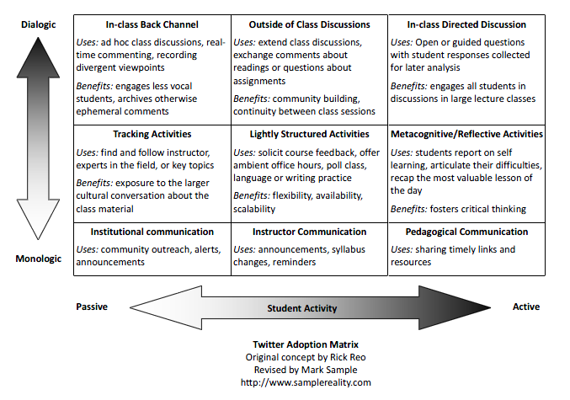
ICT in the classroom conference
Twitter twinking
Source: http://tinyurl.com/yksnmeg
Notes:
[twitter] twitter adoption matrix http://tinyurl.com/yksnmeg [/twitter]

Slide 7

ICT in the classroom conference
Twitter twinking
How do we get from Tweeting
to thinking?
twinking?
Are you/we thinking yet?
Notes:
[twitter] How do we get from tweeting to thinking=> twinking? [/twitter]

Slide 8
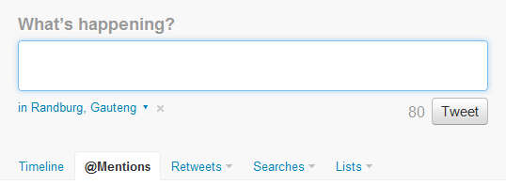
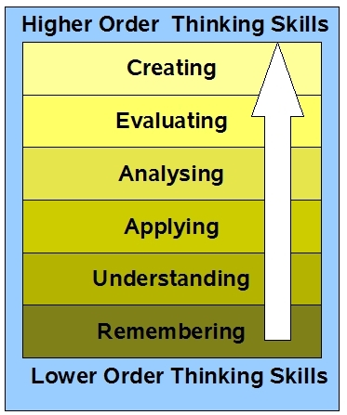
ICT in the classroom conference
Twitter twinking
Oops I think I just farted.
Is this a twink?
Blooms revised taxonomy
Source: http://bit.ly/fuTKU1
My Blooms resources:
http://www.diigo.com/user/maggiev/blooms
Notes:
[twitter] Those who have to twigged onto the educational value of twitter often say tweets are trivial [/twitter]

Slide 9
ICT in the classroom conference
Twitter twinking
What will your classroom look like in 5 years time?
Is this a twink?
Blooms revised taxonomy
Source: http://bit.ly/fuTKU1
My Blooms resources:
http://www.diigo.com/user/maggiev/blooms

Slide 10
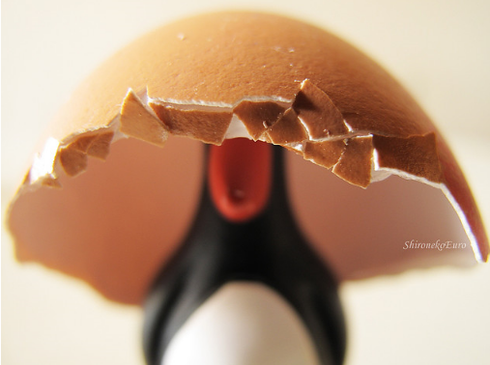
ICT in the classroom conference
Twitter twinking
Put on your twinking caps
Create a thinking cap
  Innovative
  Practical
  ….
Is this a twink?
Notes:
http://www.flickr.com/photos/shironekoeuro/4432797164/
[twitter] Please take a photo with your cellphone of your thinking cap and upload 2 twitter?[/twitter]

Slide 11
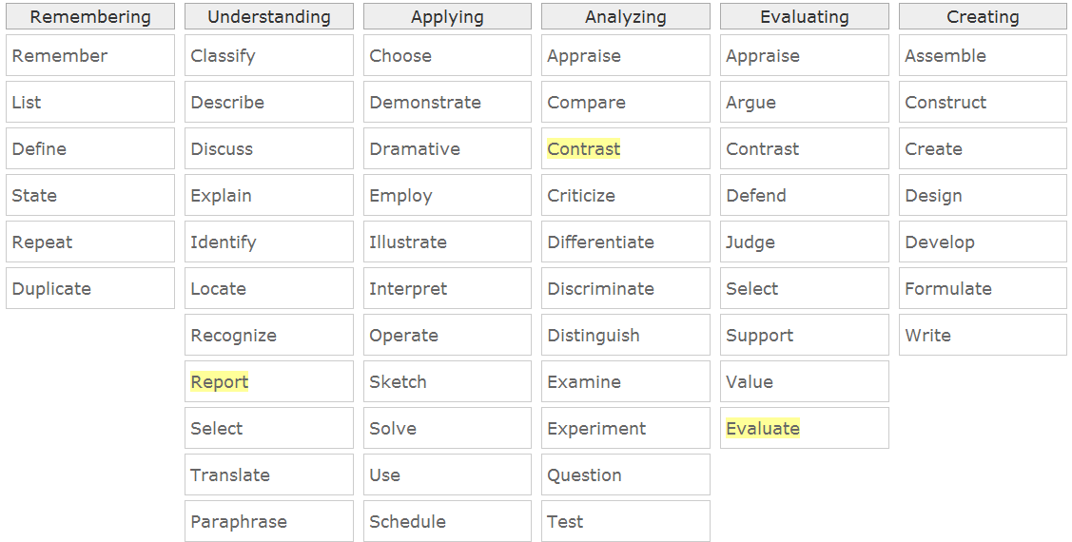
ICT in the classroom conference
Twitter twinking
Source:
Differentiator
Notes:
[twitter] Blooms interactive differentiator http://www.byrdseed.com/differentiator/ [/twitter]

Slide 12

ICT in the classroom conference
Twitter twinking
Questions
Privacy?
Disruption?
Issues?
What do YOU twink?
Notes:
Picture source: http://www.flickr.com/photos/mytudut/5189224738/

Slide 13
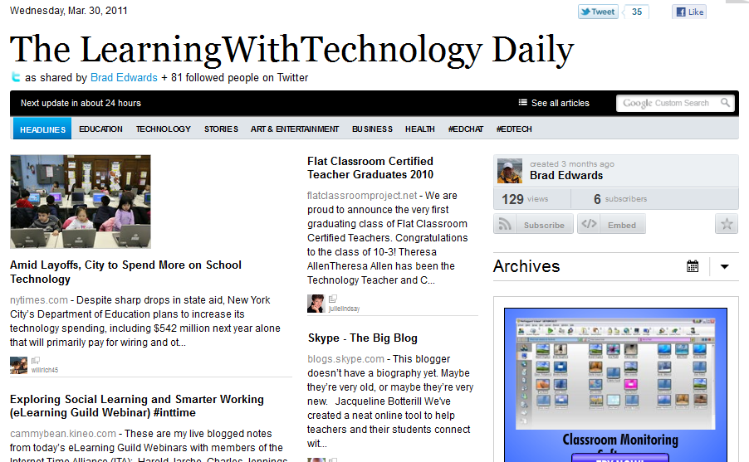
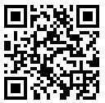
ICT in the classroom conference
Twitter twinking
Some tools
Hootsuite.com
tweetdeck.com
Url shorteners:
Bit.ly/ goo.gl
Paper.li
Lots more tools:
Browser addon
Twitter tools
database
Tweetdoc.org
Notes:
[twitter] Some tools to manage your multiple personas www.hootsuite.com or www.tweetdeck.com [/twitter]
[twitter] Shorten your urls Bit.ly or goo.gle (can create a QR code) [/twitter]
[Twitter] Create a backchannel PDF at tweetdoc.org [/twitter]

Slide 14
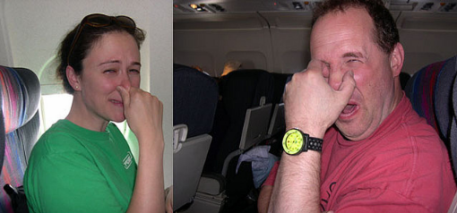
ICT in the classroom conference
Twitter twinking
Homework
Get stuck in today #schoolnetsa11
Comment
Twink about what the speakers say.
Get your students to twink
Don’t stink
-
Twink
Notes:
[twitter] How Prof Parry used twitter with his students http://chronicle.com/blogPost/A-Professor-s-Tips-for-Using/3643 [/twitter]
[twitter] Don’t stink- twink [/twitter]
Picture source: http://farm1.static.flickr.com/7/6554842_b55d3f789d_t.jpg

